Slide 1

Farmers' Market Setup and Launch
Project by: Ali Abedini, Elham Keshavarzsafiei, Aynaz Sardast, Shakiba Salmanpour, and Md Fahim Hossain

Slide 2
Project Overview
This project aims to establish a Farmers' Market where local farmers and artisans can sell fresh produce and handmade goods directly to the community. It promotes local agriculture, strengthens community ties, and supports sustainable practices.

Slide 3
PROJECT CHARTER
Project name | Farmers' Market Setup and Launch | Project ID |  | FM-001
Client | University
Project manager | Md Fahim Hossain
Business case | The establishment of a farmers' market aims to provide the local community with fresh, locally grown produce and products while supporting local farmers and promoting sustainable agriculture. This project will focus on setting up the infrastructure, recruiting vendors, and ensuring a successful market launch. The actual operation of the market after the launch will not be part of the project.
Main goal | To successfully set up and launch the first day of a farmers' market, providing a platform for local vendors to sell their goods, and ensuring the market's infrastructure and logistics are in place for smooth operation on launch day.
Important stakeholders | Local Community: The potential customers of the market. Farmers/Vendors: Local producers and artisans participating in the market. Local Authorities/Regulatory Bodies: Ensuring all legal and health requirements are met for the market setup. Project Team Members: Responsible for planning and execution. Marketing Partners: Responsible for advertising and publicizing the market before its launch.
Risks | Vendor Non-participation or Delayed Sign-ups: Mitigated by early vendor outreach and clear contracts. Permit Delays or Legal Hurdles: Mitigated by starting the permit process early and close collaboration with local authorities. Weather Impact on Market Setup: Mitigated by choosing a location with an indoor contingency or by having flexible plans for outdoor setups. Budget Overruns: Managed by carefully tracking all expenses and adjusting plans where necessary to stay within the approved budget.
Total project budget | €24,500
Costs | Human Resources: €8,500 Internal: Not Calculated External: Not Calculated Risk Surcharge: €4,400 |  | Material: €11,150
Time frame | Start: 11.10.24 |  | Finish: 10.01.25
Important milestones | Market Research & Location Secured: 24.10.24 Vendor Recruitment Complete: 12.12.24 Marketing Campaign Launch: 13.12.24 Market Setup Complete: 09.01.25 Market Opening Day: 10.01.25

Slide 4
Goals of the Project
1. Successfully launch the Farmers' Market within the set timeline.
2. Ensure collaboration among team members for smooth execution.
3. Provide an accessible and organized venue for farmers and artisans.
4. Promote sustainability through locally sourced products.
5. Attract and engage vendors and customers via targeted marketing.

Slide 5
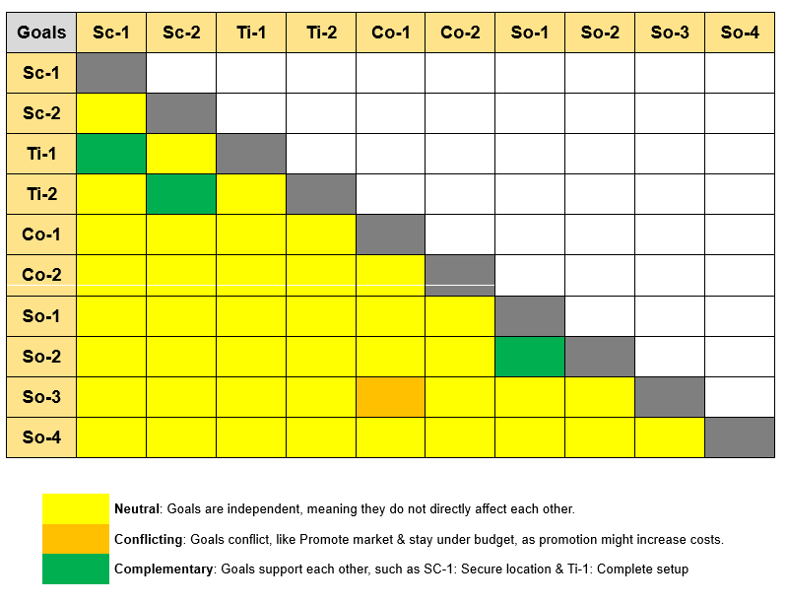
Sc-1 (Secure a Location) & Ti-1 (Complete Setup): Type: Complementary Summary: A secured location is essential for completing the setup, as it provides the foundation for infrastructure and stall installation. Sc-2 (Obtain Permits) & Ti-2 (Launch Market on Time): Type: Complementary Summary: Securing permits on time is critical to launching the market as scheduled; delays may hinder the opening. Co-1 (Stay Under Budget) & So-3 (Promote Market via Social Media): Type: Conflicting Summary: Extensive marketing may exceed the allocated budget, creating a conflict between staying under budget and promoting effectively. So-1 (Attract Vendors) & So-2 (Attract Visitors): Type: Complementary Summary: More vendors increase market appeal, leading to higher visitor attendance on the opening day. Co-2 (Collect Vendor Payments) & Ti-2 (Launch Market on Time): Type: Neutral Summary: These tasks are independent and do not directly impact each other, as they can be managed simultaneously.

Slide 6
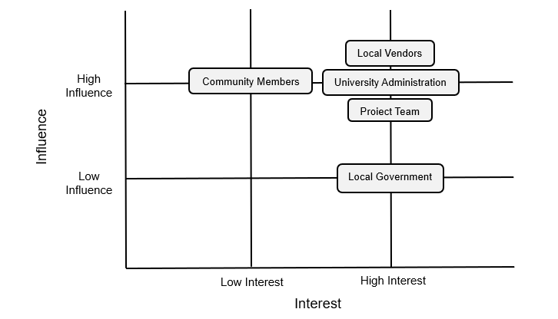
Stakeholders
No | Stakeholder | Expectations of the Stakeholder | Conflict Potential (high/low) | Power (high/low) | Actions to be taken
1 | Local Vendors | Vendors expect a well-organized platform to sell their goods and attract customers. | Low | High | Provide regular updates on market setup, ensure fair allocation of stalls, and offer promotional support for vendor products.
2 | Community Members | Expect access to fresh produce, a community-driven event, and an enjoyable shopping experience. | Low | Low | Promote the market through social media, host pre-launch events to generate interest, and ensure the market layout is customer friendly.
3 | University Administration | Expects adherence to academic guidelines, proper resource utilization, and timely project completion. | High | High | Maintain transparency through progress reports, ensure compliance with university policies, and address concerns promptly.
4 | Local Government | Expects the project to comply with legal regulations, safety standards, and permit requirements. | High | High | Submit all required documents early, address regulatory feedback, and maintain open communication with authorities.
5 | Project Team | The team expects clear task delegation, collaborative problem-solving, and successful completion of the project. | Low | High | Conduct regular team meetings, utilize project management tools for tracking, and provide support to resolve internal challenges.

Slide 7
Risk Management Strategies
1. Permit Delays: Mitigate through early applications.
2. Budget Overruns: Monitor expenses closely.
3. Adverse Weather: Have contingency plans for outdoor setups.
4. Low Vendor Participation: Engage vendors early through outreach.
5. Inefficient Tools: Use regular testing and backups.

Slide 8
Project Phases
No | Phase Name | Start Date | End Date | Description of the Phase (Activities & Outcomes)
1 | Initiation | 2024-10-11 | 2024-10-24 | Activities: Define project scope, identify stakeholders, and create a project charter. Outcome: Approval of project objectives and alignment with stakeholders.
2 | Planning | 2024-10-25 | 2024-11-21 | Activities: Develop detailed project plans, including timelines, budgets, and risk assessments. Outcome: A comprehensive project plan with clearly defined roles, deliverables, and communication strategies.
3 | Vendor Recruitment | 2024-11-22 | 2024-12-12 | Activities: Identify and onboard local vendors, finalize contracts, and communicate market expectations. Outcome: Commitment from a sufficient number of vendors to participate in the market.
4 | Marketing and Promotion | 2024-12-13 | 2024-12-27 | Activities: Design and execute marketing campaigns using social media, flyers, and local outreach. Outcome: High community awareness and confirmed attendance for the market launch.
5 | Setup and Logistics | 2024-12-27 | 2025-01-09 | Activities: Prepare the market location, install infrastructure, and coordinate utilities and signage. Outcome: A fully operational and visually appealing market setup ready for launch.
6 | Launch and Evaluation | 2025-01-10 | 2025-01-17 | Activities: Host the market launch event, gather feedback from attendees, and evaluate the project outcomes. Outcome: A successful market opening and documented lessons for future improvements.

Slide 9
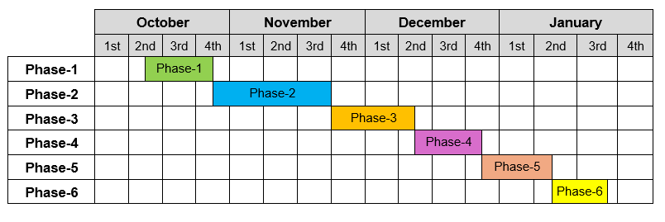
Graphical Representation Of Project Phases
Phase-1: Initiation
Phase-2: Planning
Phase-3: Vendor Recruitment
Phase-4: Marketing Campaign Launched
Phase-5: Setup and Logistics
Phase-6: Launch and Evaluation

Slide 10
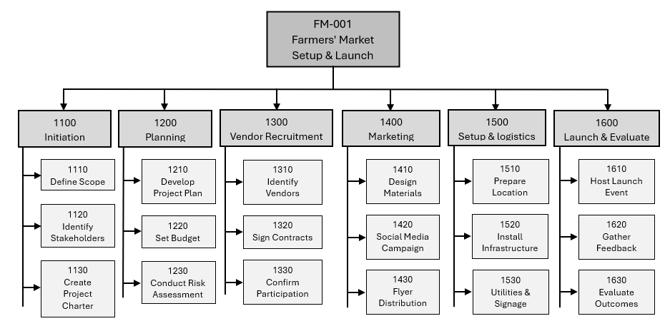
Project Structure Plan Graph

Slide 11
Work Package 1: Define Scope
Work Package 1: Define Scope
Date: 2025-01-02 | Version: 1.0 | WP Nr.: 1110 | Project: Farmers' Market Setup and Launch
Project phase | Initiation
WP Owner | Market Researcher & Location Specialist
Result(s) | Approved project scope document
Activities | Conduct stakeholder meetings Draft the scope document Get approval from the Steering Committee
Pre-requirements | Identified stakeholders and project objectives
Risks | Delays in stakeholder availability
Estimated costs | €300
Workload | 15 hours
Progress measurement | 30% done when the first draft is complete 50% done when feedback from stakeholders is integrated 100% done when the scope document is approved
Start | 2024-10-11
Finish | 2024-10-24
Project team members involved | Project Manager Steering Committee

Slide 12
Work Package2:Develop Project Plan
Work Package 2: Develop Project Plan
Date: 2025-01-02 | Version: 1.0 | WP Nr.: 1210 | Project: Farmers' Market Setup and Launch
Project phase | Planning
WP Owner | Project Manager
Result(s) | Approved project plan including timeline, budget, and risk management strategy
Activities | Gather requirements Create the project timeline, Allocate resources & Identify risks
Pre-requirements | Completed project scope and stakeholder alignment
Risks | Misaligned timelines or overlooked risks
Estimated costs | €500
Workload | 25 hours
Progress measurement | 30% done when draft plan is ready 50% done when feedback from team leads is integrated 100% done when the plan is approved
Start | 2024-10-25
Finish | 2024-11-21
Project team members involved | Project Manager Team Leads Steering Committee

Slide 13
Work Package3: Recruit Vendors
Work Package 3: Recruit Vendors
Date: 2025-01-02 | Version: 1.0 | WP Nr.: 1310 | Project: Farmers' Market Setup and Launch
Project phase | Vendor Recruitment
WP Owner | Vendor Relations Manager
Result(s) | Contracts signed with at least 10 vendors
Activities | Identify potential vendors Conduct outreach Finalize contracts
Pre-requirements | Vendor database and market expectations
Risks | Low vendor participation
Estimated costs | €400
Workload | 20 hours
Progress measurement | 30% done when five vendors express interest 70% done when five contracts are signed 100% done when all contracts are finalized
Start | 2024-11-22
Finish | 2024-12-12
Project team members involved | Vendor Relations Manager Marketing Lead

Slide 14
Work Package4: Launch Marketing Campaign
Work Package 4: Launch Marketing Campaign
Date: 2025-01-02 | Version: 1.0 | WP Nr.: 1410 | Project: Farmers' Market Setup and Launch
Project phase | Marketing and Promotion
WP Owner | Marketing Lead
Result(s) | Increased awareness with at least 200 attendees at the launch
Activities | Design social media campaigns Create promotional materials Distribute flyers
Pre-requirements | Approved vendor list and allocated marketing budget
Risks | Ineffective outreach or budget overruns
Estimated costs | €600
Workload | 30 hours
Progress measurement | 30% done when social media materials are created 70% done when all materials are distributed 100% done when the campaign ends with confirmed participation
Start | 2024-12-13
Finish | 2024-12-27
Project team members involved | Marketing Lead Project Manager

Slide 15
Budget Overview
- Total Budget: €24,500
- Human Resources: €8,500
- Material Costs: €11,150
- Risk Surcharge: €4,400
The budget includes marketing, logistics, and infrastructure costs.

Slide 16
Project Timeline
The project timeline spans from October 2024 to January 2025, with key milestones:
- October: Initiation and Planning.
- November: Vendor Recruitment.
- December: Marketing and Setup.
- January: Launch and Evaluation.

Slide 17
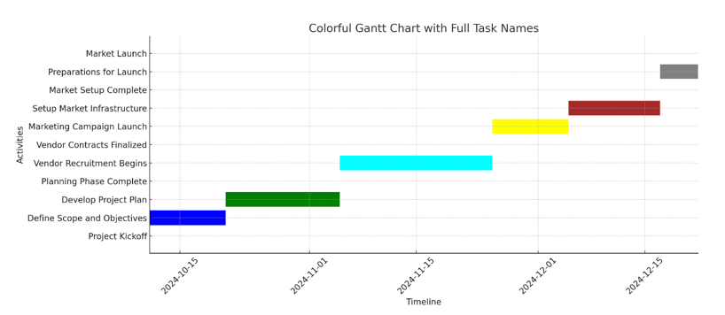
Gantt Chart

Slide 18
Cost Planning
No | Resource | Type of Resource | Quantity (hours or pieces) | Costs per Unit (€) | Total Costs (€)
1 | Project Manager | Human Resource | 100 hours | €20 | €2,000
2 | Market Research & Location Specialist | Human Resource | 75 hours | €20 | €1,500
3 | Vendor Relations & Recruitment | Human Resource | 75 hours | €20 | €1,500
4 | Marketing & Promotion Specialist | Human Resource | 90 hours | €20 | €1,800
5 | Logistics & Operations Specialist | Human Resource | 75 hours | €20 | €1,500
6 | Flyers and Posters | Material | 300 flyers/ 30 posters | €1 per flyer/poster | €300
7 | Registration Forms | Material | 100 forms | €0.5 | €50
8 | PA System | Machine | 1 | €300 | €300
9 | Laptops | Machine | 2 | €0 | €0
10 | Basic Setup Tools | Tools | Multiple | €300 | €300
11 | Vendor Booths | Parts from Suppliers | 20 | €350 | €7,000
12 | Produce Stands | Parts from Suppliers | 10 | €200 | €2,000
13 | Branded Banners/Signage | Parts from Suppliers | 5 | €300 | €1,500

Slide 19
Total Price Costing
Total Project Costs
The total project costs, including the resource costs and risk surcharge, are summarized below:
Resource Costs: €19,750
Risk Surcharge: €4,400
Total Project Budget: €24,150
By incorporating the risk surcharge and detailed cost breakdown, this cost plan ensures the project is financially prepared to manage unforeseen challenges while delivering a successful market launch.

Slide 20
Marketing Strategies
1. Use social media platforms (Instagram, Facebook).
2. Create and distribute promotional flyers.
3. Host pre-launch events for community engagement.
4. Highlight vendors through targeted campaigns.

Slide 21
Evaluation and Feedback
1. Collect feedback from attendees and vendors.
2. Measure success by attendance and satisfaction.
3. Document lessons for future improvements.

